Slide 1
Expedia Hotel price prediction
Weekly Update 13
Team Dragonflies

Slide 2
Content
Property feature group analysis
Modeling based on time features

Slide 3
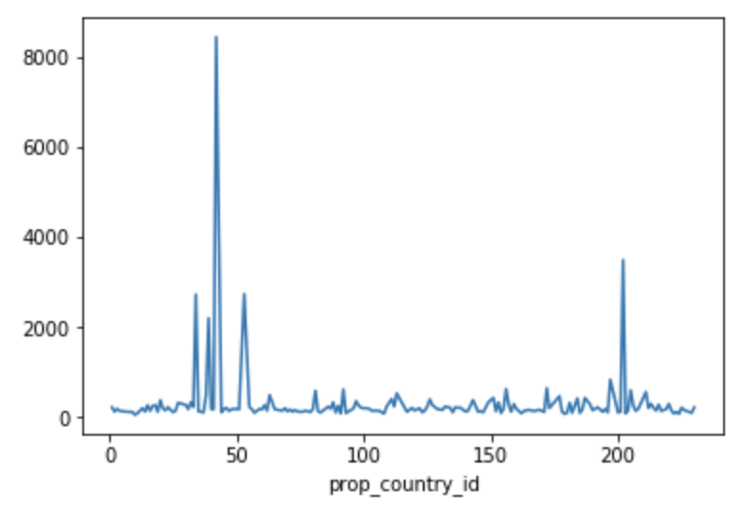
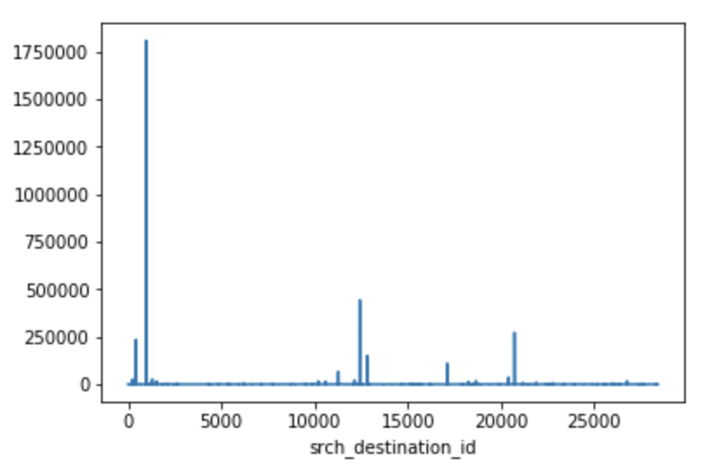
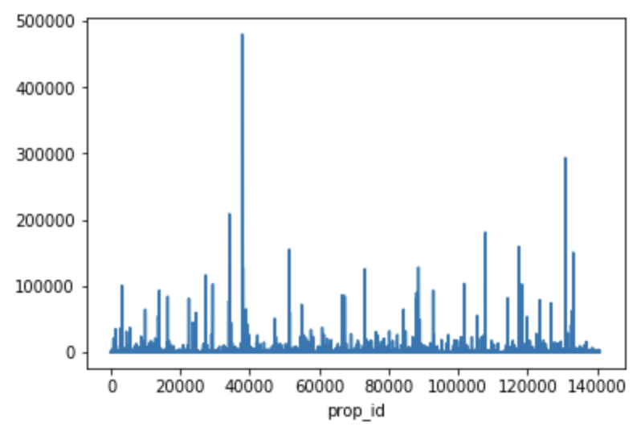
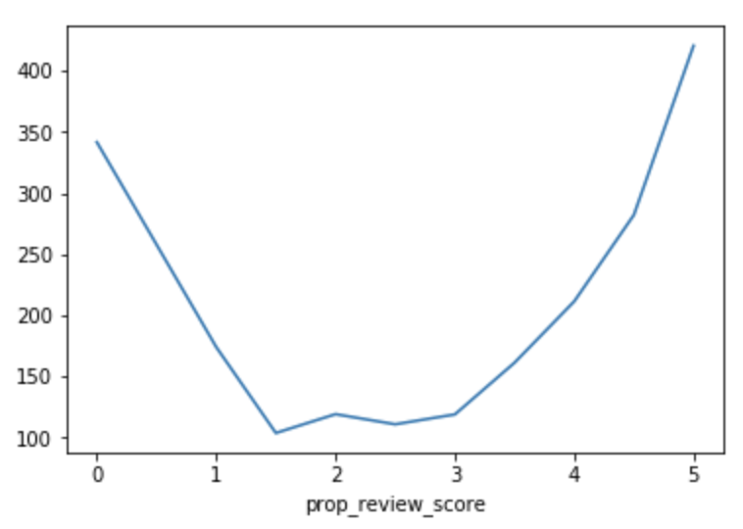
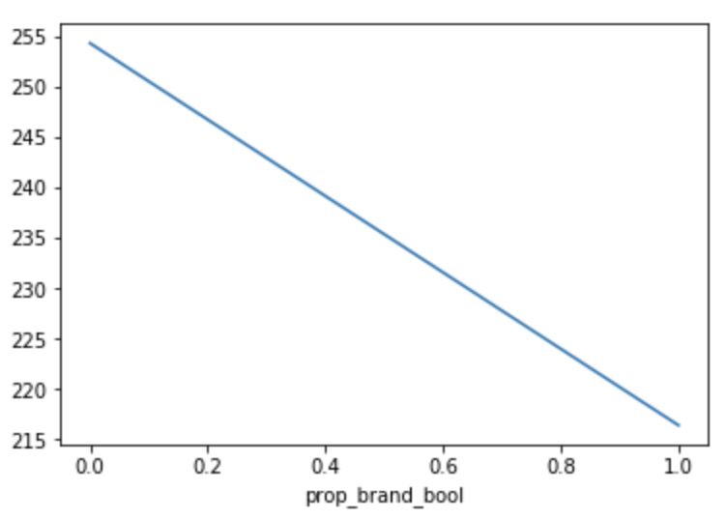
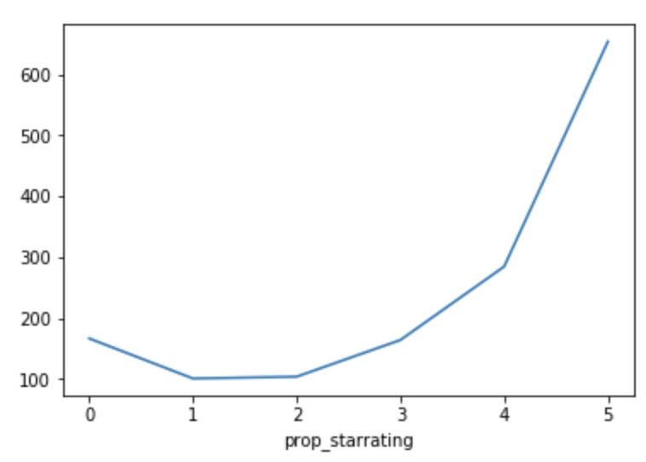
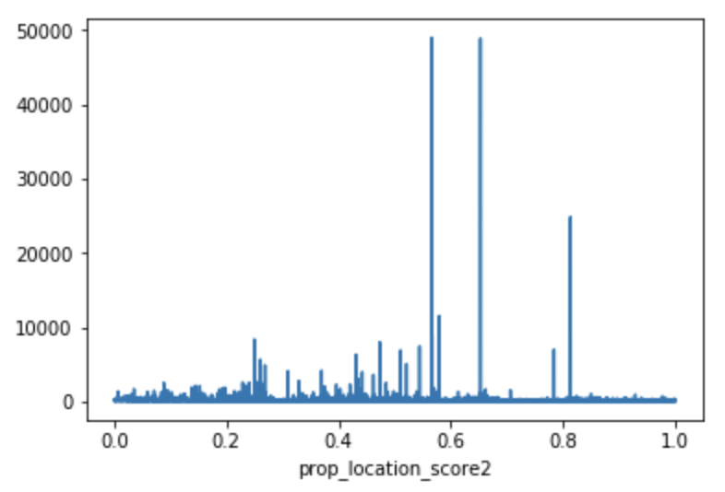
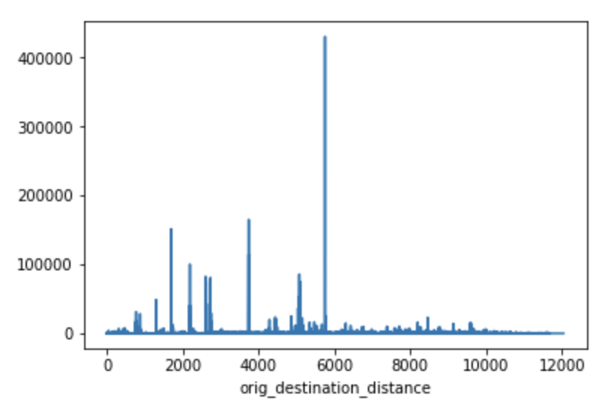
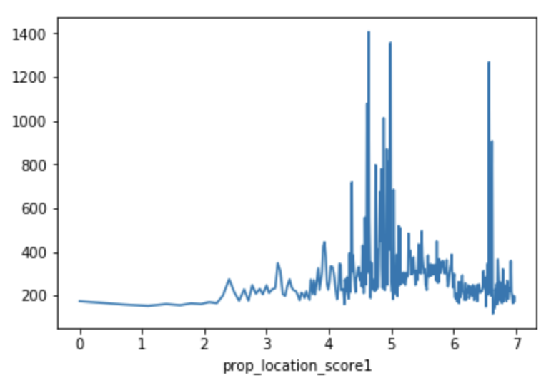
Volatility of property features

Slide 4
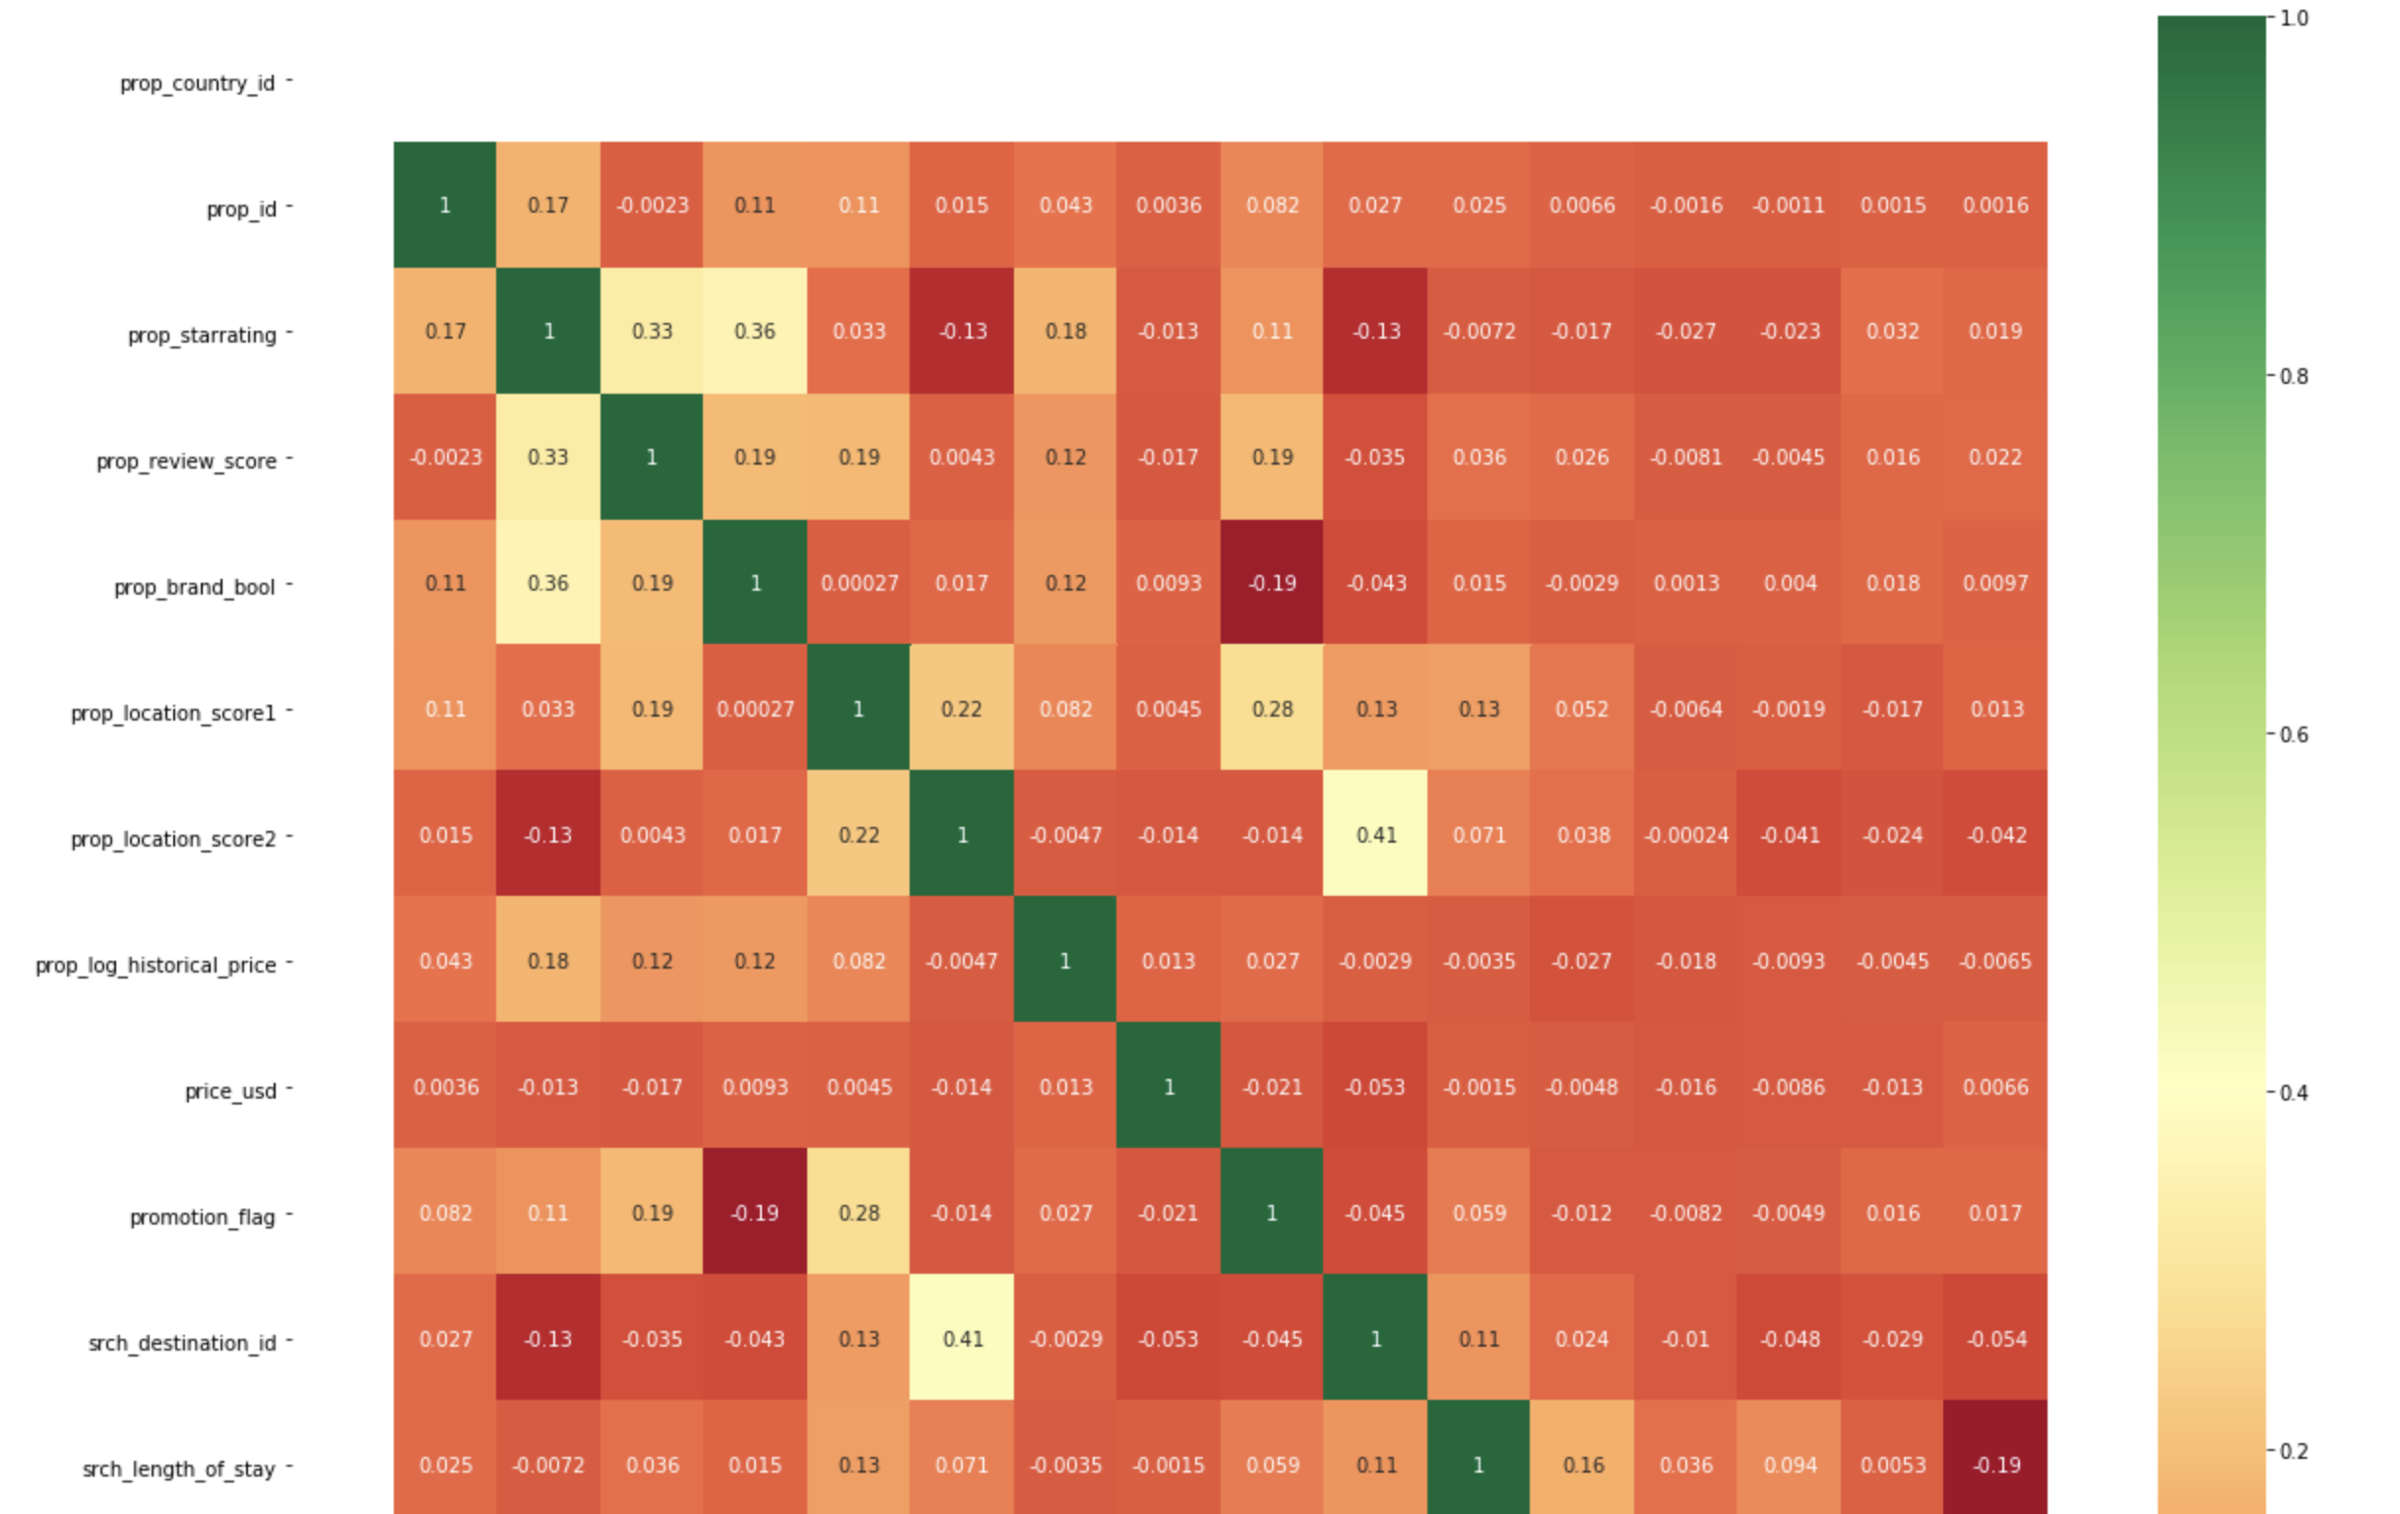
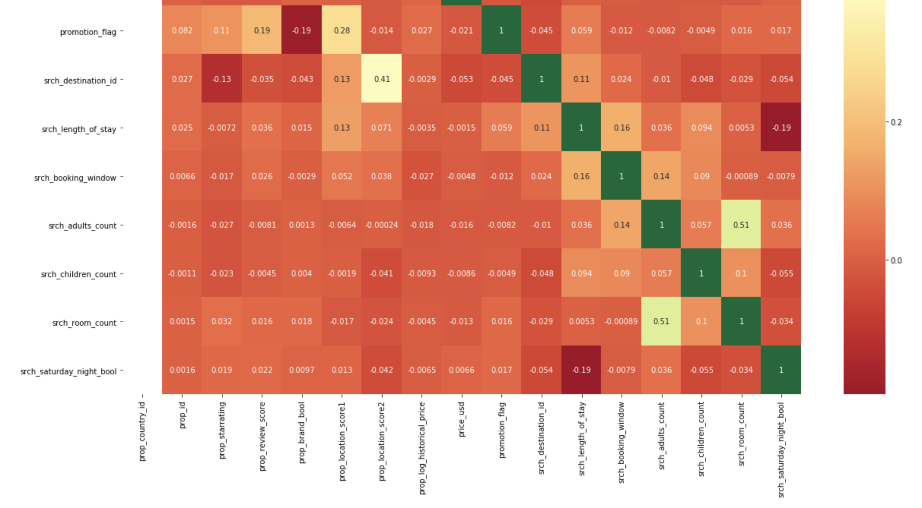
Heatmap of correlated features

Slide 5
Property feature
modeling
Data process:
aggregating price data by prop_country_id
Prop_country_id = 225 is the country with the largest number of records in dataset (44358 records)
Data modeling:
training size: 28389
validation size: 7097
test size: 8871
 | Linear Regression | Ridge | Decision Tree
Training RMSE | 2633.64 | 2633.64 | 71.93
Validation RMSE | 1033.34 | 1033.34 | 2438.67

Slide 6
Pipeline structure
Pipeline structure
Users
Modeling 1
stacking
clustering
Properties
Modeling 2
Time
Modeling 3
Time interact with Properties
Modeling 4
Competitors
Modeling 5
Other
Modeling 6

Slide 7
Time feature
modeling
Data process:
aggregating price data by day + by destination (‘city’) + by star_rating
So far, have tried fitting model for properties with 4-star ratings within destination 8192
*Rationale:
8192 is the city with the largest number of records in dataset
4 star is the star rating associated with the largest number of records in this city

Slide 8
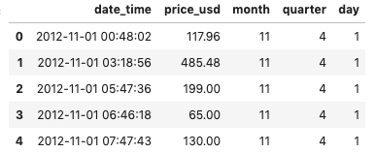
Time feature
modeling
model 1: ARIMA time series model
train RMSE: 68.994
test RMSE: 52.177
model 2: linear regression model With extracted time-related features:
‘month’,’day’,’quarter’
train RMSE: 60.50
test RMSE: 55.71

Slide 9
Time feature
modeling
stacking model 1 and model 2:
Using prediction results from the previous two models as new features, and fit a second-layer regression model
2nd layer modeling | train_RMSE | test_RMSE
xgboost | 63 | 81
ridge | 44 | 41
linear regression | 44 | 41

